Slide 1
Data Encryption Standard
(DES)
http://fc07.ifca.ai

Slide 2
Encryption Basic Idea.
Two approaches:
plaintext
1) Make algorithm secret
and don’t use a key.
Key
Bad Idea
algorithm
2) Make algorithm public
but keep the key secret.
ciphertext
Good Idea

Slide 3
Cryptography - Making and breaking of secret codes
Translation of the original message into a new incomprehensible one by a mathematical algorithm using a specific KEY
Plaintext - a message or data
Cipher text - coded text
Decryption - decoding back to plaintext

Slide 4
Encryption Algorithm:
Coding scheme or cryptographic algorithm
Specific sequence of characters key used by the algorithm
Basic requirement is that it must be able to turn plain text into cipher text in such a way that only the intended recipient – the holder of the decryption key – can recover the plain text
Best cryptographic algorithms can prevent any attacker from deducing the key even when the individual knows both the plain text and the cipher text

Slide 5
Methods of Encryption.
Symmetric/Private Key /Single Key Cryptography.
Asymmetric/Public Key/Two Key Cryptography.

Slide 6
Symmetric/Private Key Cryptography.
Use the same key to encrypt and decrypt (secret key)
Requires a more secure system to send the key to the other party.
Strengths
  Much faster than asymmetric systems
  Hard to break with a large key size
Weaknesses
  Requires secure delivery mechanism
  Do not provide authenticity

Slide 7
Symmetric Key Cryptography
Sender
(A)
Receiver
(B)
Network
Plain text
Cipher text
Cipher text
Plain text
Encrypt with symmetric key
Decrypt with symmetric key

Slide 8
Symmetric/Private Key Algorithms.
Examples
Data Encryption Standard (DES)
Triple-DES (3DES)
Blowfish
IDEA
RC4, RC5, and RC6
Advanced Encryption Standard (AES)

Slide 9
Asymmetric/Public Key Cryptography.
Use a key (public key) to encrypt a message
Another (private key) to decrypt it
Private key known to owner and used only by owner
Strengths
  Better key distribution than symmetric systems
  Better scalability than symmetric systems
  Can provide authentication
Weaknesses
  Works more slowly than symmetric systems
  Mathematically intensive tasks

Slide 10
Asymmetric/Public Key Algorithms
Examples
RSA
Elliptic Curve Cryptosystem (ECC)
Diffie-Hellman
El Gamal
Digital Signature Algorithm (DSA)
Knapsack

Slide 11
Ciphers
Mechanism that decides the process of encryption/decryption
Stream Cipher: Bit-by-bit encryption / decryption
Block Cipher: Block-by-block encryption / decryption

Slide 12
Types of Cipher
Algorithm Types
Stream Ciphers
Block Ciphers

Slide 13
Stream Cipher Example
In normal format
In binary format
Pay 100
Plain text
010111001
+
100101011
XOR operation with the key
ZTU91_^%D
11001001
Cipher text

Slide 14
Block Cipher Example
FOUR
_AND_
FOUR
Plain text
Encrypt
Encrypt
Encrypt
VFa%
*yT1x
VFa%
Cipher text
(a) The Encryption Process at the sender’s end
VFa%
*yT1x
VFa%
Cipher text
Decrypt
Decrypt
Decrypt
FOUR
_AND_
FOUR
Plain text
(b) The Decryption Process at the receiver’s end

Slide 15
Algorithm Modes
Add randomness to block cipher
Otherwise, block cipher becomes predictable
Four main modes

Slide 16
Algorithm Modes
Algorithm Modes
Electronic Code Book (ECB)
Cipher Block Chaining (CBC)
Cipher Feedback (CFB)
Output Feedback (OFB)
These two modes work on block ciphers.
These two modes work on block ciphers acting as stream ciphers.

Slide 17
Encryption in ECB Mode
Plain text block 1
Plain text block 2
Plain text block n
Key
Encrypt
Key
Encrypt
Key
Encrypt
Cipher text block 1
Cipher text block 2
Cipher text block n
Step 1
Step 2
Step n

Slide 18
Decryption in ECB Mode
Cipher text block 1
Cipher text block 2
Cipher text block n
Key
Decrypt
Key
Decrypt
Key
Decrypt
Plain text block 1
Plain text block 2
Plain text block n
Step 1
Step 2
Step n

Slide 19
Encryption in CBC Mode
IV
Plain text block 1
Plain text block 2
Plain text block n
XOR
XOR
XOR
Key
Encrypt
Key
Encrypt
Key
Encrypt
Cipher text block 1
Cipher text block 2
Cipher text block n
Step 1
Step 2
Step n

Slide 20
Decryption in CBC Mode
Cipher text block 1
Cipher text block 2
Cipher text block n
Key
Decrypt
Key
Decrypt
Key
Decrypt
IV
XOR
XOR
XOR
Plain text block 1
Plain text block 2
Plain text block n
Step 1
Step 2
Step n

Slide 21
Encryption in CFB Mode
IV
(Shift register)
IV
(Shift register)
IV
(Shift register)
Key
Encrypt
Key
Encrypt
Key
Encrypt
Take just the leftmost 8 bits
Take just the leftmost 8 bits
Take just the leftmost 8 bits
XOR
XOR
XOR
Plain text j bits
Plain text j bits
Plain text j bits
Cipher text j bits
Cipher text j bits
Cipher text j bits

Slide 22
Encryption in OFB Mode
IV
(Shift register)
IV
(Shift register)
IV
(Shift register)
Key
Encrypt
Key
Encrypt
Key
Encrypt
Take just the leftmost 8 bits
Take just the leftmost 8 bits
Take just the leftmost 8 bits
XOR
XOR
XOR
Plain text j bits
Plain text j bits
Plain text j bits
Cipher text j bits
Cipher text j bits
Cipher text j bits

Slide 23
Data Encryption Standard
Overview..

Slide 24
Introduction.
What is DES / 3DES ?
  It is an encryption algorithm – 3DES is a federal standard.
  Symmetric system – uses the same key to encrypt/decrypt data.
  Triple DES (3DES) uses 3 stages of DES to give better protection.
Key
Plaintext
Encrypt
DES
Ciphertext
Decrypt
Key

Slide 25
History of DES.
IBM developed Lucifer algorithm for banking systems (1970’s )
  NIST and NSA evaluate and modify Lucifer (1974)
Modified Lucifer adopted as federal standard (1976)
  Name changed to Data Encryption Standard (DES)
  Defined in FIPS (46-3) and ANSI standard X9.32
NIST defines Triple DES (3DES) (1999)
  Single DES use deprecated - only legacy systems.

Slide 26
The DES Approach
Make the algorithm so complicated that virtually none of the structure of the plain text remains in the cipher text
This leaves the attacker no choice but to search for possible keys which is exhaustive

Slide 27
Conceptual View of DES
64-bit Plain text
64-bit Plain text
64-bit Plain text
•••
56-bit Key
56-bit Key
56-bit Key
DES
DES
DES
64-bit Cipher text
64-bit Cipher text
64-bit Cipher text
Block 1
Block 2
Block n

Slide 28
Basic DES Algorithm.
DES is a block cipher.
DES uses lots of scrambling.
DES uses XOR technique internally.
Message block size is 64 bits each.
Key used to encrypt is 64 bits.
DES encrypts a 64-bit block of plain text using a 64-bit key
Only 56 of the 64 bits in the key are usable, the last bit of each 8 bits in the key is a parity bit for that byte

Slide 29
3 DES Phases
64 bits in the block are permuted (shuffled)
Sixteen rounds of an identical operation are applied to the resulting data and the key.
The inverse of the original permutation is applied to the result

Slide 30
Broad Level Steps in DES
Step 1
Plain text (64 bits)
Step 2
Initial Permutation (IP)
Step 3
LPT
RPT
16 rounds
16 rounds
Key
Step 4
Key
Step 5
Final Permutation (FP)
Step 6
Cipher text (64 bits)

Slide 31
IP (Initial Permutation): Message Block
8
16
24
32
40
48
56
8
16
24
32
40
48
56

Slide 32
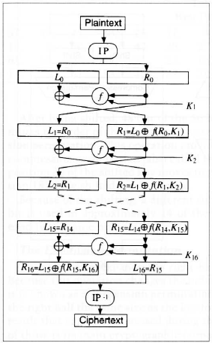
High-level outline of DES
During each round the 64-bit block is broken into two 32-bit halves and a different 48 bits are selected from the 56-bit key
Li and Ri are the left and right halves, Ki is the 48-bit key
Li = Ri-1
Ri = Li-1 XOR F(Ri-1, Ki)

Slide 33
Details of One Round in DES
Key Transformation
Expansion Permutation
S-Box Substitution
P-Box Permutation
XOR and Swap

Slide 34
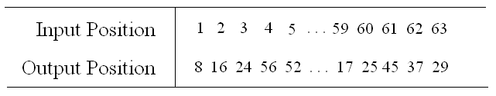
DES Key Determination
How is the key derived?
Initial K is permuted as follows:

Slide 35
PC-1: Permuted Choice 1
Bit
0
1
2
3
4
5
6
1
57
49
41
33
25
17
9
8
1
58
50
42
34
26
18
15
10
2
59
51
43
35
27
22
19
11
3
60
52
44
36
29
63
55
47
39
31
23
15
36
7
62
54
46
38
30
22
43
14
6
61
53
45
37
29
50
21
13
5
28
20
12
4

Slide 36
Key Generation Technique.
Initial Key Permutation
8
16
24
32
40
48
56
64
8
16
24
32
40
48
56

Slide 37
DES Key Determination (cont’d)
For each round, the 56-bit key is divided into two 28-bit halves and each halve is independently rotated left either one or two positions, depending on the round
The 56-bit result is used as the input for the next round and to select the 48 bits that make up the key for the current round

Slide 38
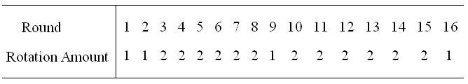
DES Key Determination (cont’d)
64-bit key → 56-bit key (8 bits for parity) → 48-bit key (compressed)
The key halves are rotated as follows:

Slide 39
Key Split & Shift & Compress
8
16
24
32
40
48
56
K₅₆
Shift left by N_{i}
Shift left by N_{i}
Shift accumulates every round
N_{i} = {1,1,2,2,2,2,2,2,1,2,2,2,2,2,2,1}
8
16
24
32
40
48
56
K₄₈
8
16
24
32
40
48

Slide 40
PC-2: Permuted Choice 2
Bit
0
1
2
3
4
5
1
14
17
11
24
1
5
7
3
28
15
6
21
10
13
23
19
12
4
26
8
19
16
7
27
20
13
2
25
41
52
31
37
47
55
31
30
40
51
45
33
48
37
44
49
39
56
34
53
43
46
42
50
36
29
32

Slide 41
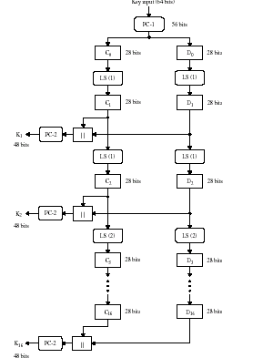
Key Schedule for DES

Slide 42
DES
64 bit plaintext block
IP
L₀
R₀
32
32
K₁ (derived from
56 bit key)
f
L₁=R₀
R₁=L₀ + f(R₀,K₁)
repeat 16 times…
K₁₆ (derived from
56 bit key)
f
R₁₆=L₁₅ + f(R₁₅,K₁₆)
L₁₆=R₁₅
IP⁻¹
64 bit ciphertext block

Slide 43
DES Function F
Function F combines resulting 48-bit key (Ki) with right half of the data block after round i-1 (Ri-1)
Function F expands Ri-1 from 32 bits to 48 bits to combine with Ki by breaking Ri-1 into 8 4-bit chunks and expanding each chunk into 6-bits by stealing the rightmost and leftmost bit from the left and right adjacent 4-bit chunks, respectively

Slide 44
L₀
R₀
32
32
48 bit subkey
Generator
K₄₈ = g(i,K₅₆)
(The key for
each round is
deterministically
found from the
input 56 bit key).
Expansion Permutation
48
48
48
S-Box Substitution
32
P-Box Permutation
32
32
32
L₁
R₁

Slide 45
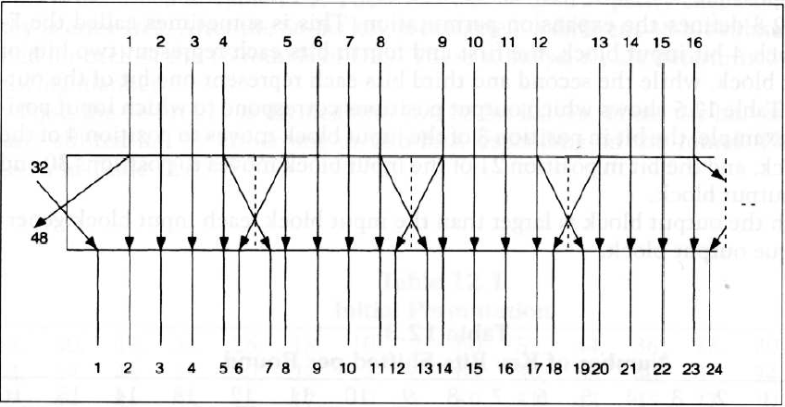
DES Expansion
Next, the 48-bit Ki is divided into 8 6-bit chunks, each chunk is XORed with the corresponding chunk that resulted from the previous expansion of Ri
Below is shown the expansion permutation

Slide 46
32
Expansion Permutation
48
1
4
5
8
9
12
13
16
17
20
21
24
25
28
29
32
1
48

Slide 47
48
48
48
1
48
X-OR with 48 bit key
1
48

Slide 48
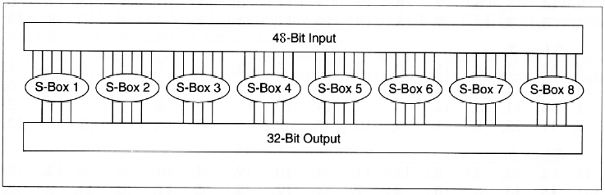
DES S box
Finally, each 6-bit value is fed through a substitution box (S box) which reduces each 6-bit chunk back into 4 bits. 8 S boxes are needed for each 6-bit chunk
Below is shown how the S boxes substitute

Slide 49
48
S-Box Substitution
32
1
48
S-box
1
S-box
2
S-box
3
S-box
4
S-box
5
S-box
6
S-box
7
S-box
8
1
4
5
8
9
12
13
16
17
20
21
24
25
28
29
32

Slide 50
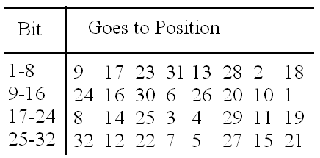
DES P box
Finally, after S box substitution, all 32 bits of the result are permuted by a straight permutation
Below is the table of permutation

Slide 51
32
P-Box Permutation
32
1
4
5
8
9
12
13
16
17
20
21
24
25
28
29
32
1
4
5
8
9
12
13
16
17
20
21
24
25
28
29
32

Slide 52
IP⁻¹ (Final Permutation):
8
16
24
32
40
48
56
8
16
24
32
40
48
56

Slide 53
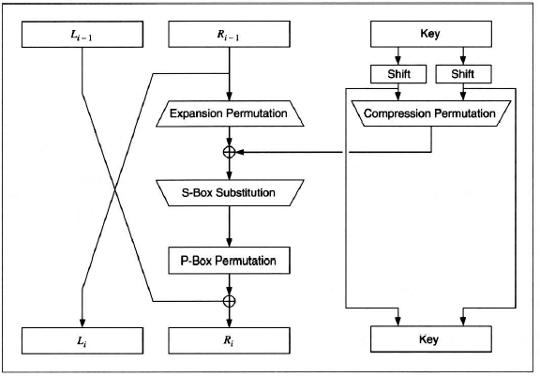
One round of DES

Slide 54
DES – Side Notes
With DES, there is no distinguishing between encryption and decryption, this is a nice feature that both sides of the algorithm work the same except that the keys are applied in reverse order after the final permutation
The only way to break a DES is exhaustively search all possible 2^56 keys

Slide 55
DES – Side Notes (cont’d)
Triple DES is basically encrypting the data 3 times
Can be done with 3 separate keys, or even with two keys (use the first, then the second, and finally the first again)
Increased security using triple DES

Slide 56
Security of DES.
Methods of Attack:
  Brute Force. ( 2⁵⁶ )
  Linear / Differential cryptanalysis ( 2⁴³ / 2⁴⁷ )
Attacks on DES:
  Challenge II (56 hrs using a supercomputer) 1998
  Challenge III (22 hrs using distibuted.net) 1999
  Dedicated hardware ($1 million) can crack it in 1 h

Slide 57
DES.
Advantages:
  Much faster than public key systems like RSA
  Easy to implement in both hardware and software
  Tested for 25 years and no logic flaws. Trusted cipher
Disadvantages:
  Transmission of secret key over public channel is tricky
  Not as fast as AES, RC6 or Blowfish which are newer.
  Key length of DES is too small but 3DES solves this.

Slide 58
Modified Versions of DES
Double DES: Perform DES twice with two different keys
Triple DES with Three Different Keys
Triple DES with Two Different Keys

Slide 59
Double DES Encryption
Original Plain Text
Cipher Text
Cipher Text
Encrypt
Encrypt
K1
K2

Slide 60
Double DES Decryption
Cipher Text
Cipher Text
Original Plain Text
Decrypt
Decrypt
K2
K1

Slide 61
Double DES Mathematically Expressed
E_{K1}(P)
T = E_{K1}(P)
E_{K2}(E_{K1}(P))
C = E_{K2}(E_{K1}(P))
P
Temporary result (T)
C
Encrypt
Encrypt
K1
K2

Slide 62
Triple DES
Original Plain Text
Cipher Text 1
Final Cipher Text
Encrypt
Cipher Text 2
Encrypt
Encrypt
K1
K2
K3

Slide 63
Triple DES with Two Keys
Original Plain Text
Cipher Text 1
Final Cipher Text
Encrypt
Cipher Text 2
Decrypt
Encrypt
K1
K2
K1

Slide 64
Broad Level Steps in IDEA
Input Plain Text (64 bits)
P1 (16 bits)
P2 (16 bits)
P3 (16 bits)
P4 (16 bits)
Round 1
.
.
K1
K6
Round 2
.
.
K7
K12
•••
Round 8
.
.
K43
K48
Output Transformation
.
.
K49
K52
C1 (16 bits)
C2 (16 bits)
C3 (16 bits)
C4 (16 bits)
Output Cipher Text (64 bits)

Slide 65
Encryption using RC5
First, divide the original plain text into two blocks of equal size. Call them as A and B.
Add A and S[0] to produce C.
Add B and S[1] to produce D.
Note: First perform all the left-hand side steps, and then come to the right hand side steps, as indicated by the step numbers.
1. XOR C and D to produce E.
4. XOR D and F to produce G.
2. Circular-left shift E by D bits.
5. Circular-left shift G by F bits.
3. Add E and S[2i] to produce F.
6. Add G and S[2i + 1] to produce H.
Increment i by 1.
Call F as C
(i.e. C = F)
Call H as D
(i.e. D = H)
No
Check:
Is i > r?
Yes
Stop

Slide 66
RC5 Encryption
A = A + S[0]
B = B + S[1]
For i = 1 to r
  A = ((A XOR B) <<< B) + S[2i]
  B = ((B XOR A) <<< A) + S[2i + 1]
Next i

Slide 67
RC5 Decryption
For i = r to 1 step –1 (i.e. decrement i each time by 1)
  B = ((B – S[2i + 1]) >>> A) XOR A
  A = ((A – S[2i]) >>> B) XOR B
Next i
B = B – S[1]
A = A – S[0]

Slide 68
Blowfish
Plain text (64 bits)
32 bits
32 bits
P1 (32 bits)
XOR
F
XOR
P2 (32 bits)
XOR
F
XOR
13 more rounds
P16 (32 bits)
XOR
F
XOR
P18 (32 bits)
XOR
P17 (32 bits)
XOR
32 bits
32 bits
Cipher text (64 bits)

Slide 69
Rijndael (AES)
Step 1: Byte Substitution
Step 2: Shift Rows
Repeat these four steps 10, 12 or 14 times.
Step 3: Mix Columns
Step 4: Round Key Addition

